Slide 1
Lec.3 Class Modeling Object and Class Concepts
Instructor : Prashant Mishra
BIAS Bhimtal

Slide 2
Class and Object as Defined by Booch, Rumbaugh and Jacobson
Class: A description of a set of objects that share the same attributes, operations, relationships, and semantics.
Object: A concrete manifestation of an abstraction; an entity with a well defined boundary and identity that encapsulates state and behavior; an instance of a class.

Slide 3
Objects
1 Objects are the basic run-time entities in an object-oriented system.
2. They may represent a person, a place , a bank account , a table of data or any item that the program must handle
3. They may also represent user-defined data.

Slide 4
Objects
Informally, an object represents an entity, be it physical, conceptual, or software
Something physical
A concept
Software
Truck
Chemical Process
Linked List
Notes:
What examples can you think of? For each class, what is its state and behaviour?

Slide 5
Objects
More formally, an object has:
State
The state of an object is represented by a set of attribute values, plus the links the object may have with other objects
An object’s state usually changes over time
Behaviour
An object’s behavior is defined by what it does in response to receiving a request (method invocation) from another object
An object can only respond to requests that it understands, i.e. methods that appear in its interface
Identity
Each object has a unique identity, even if its state is identical to that of another object
Notes:
Encapsulation – state is private and can only be changed by invoking methods. This enforces semantics / policies. E.g. withdrawing from a BankAccount object.
Identity – consider different Person objects – same name, age and gender – actually represent different people.

Slide 6
State, Behavior, Identity
State: attribute types and values
Behavior: how an object acts and reacts
Behavior is expressed through operations that can be performed on it
Identity: every object has a unique identity, even if all of its attribute values are the same

Slide 7
Classes
A class is a description of a group of objects with common:
Attributes (instance variables)
Behaviour (methods or operations forming its interface)
Links
Semantics
A class is an abstraction in that it:
Emphasises relevant characteristics (i.e. its interface)
Suppresses other characteristics (i.e. its implementation)
Objects are instances of classes
The terms object and instance are synonymous
Notes:
Abstraction:
From a class’ interface, we know what instances of the class do and we also know to use them.
To use an instance of the class, we’re not concerned with implementation details (internal data structures and algorithms).

Slide 8
Classes and Objects
Class: An entity that has a well-defined role in the application domain, as well as state, behavior, and identity
Tangible: person, place or thing
Concept or Event: department, performance, marriage, registration
Artifact of the Design Process: user interface, controller, scheduler
Object: a particular instance of a class
Objects exhibit BEHAVIOR as well as attributes
➔ Different from entities

Slide 9
Example of Class
Mango, apple and orange are members of the Fruit class
Fruit
Class
apple
orange
mango
Member of fruit class

Slide 10
Representing Objects
An object is represented as rectangles with underlined names
: Professor
a + b = 10
ProfessorClark
Class Name Only
Professor Clark
ProfessorClark :
Professor
Object Name Only
Class and Object Name

Slide 11
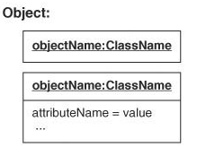

Slide 12
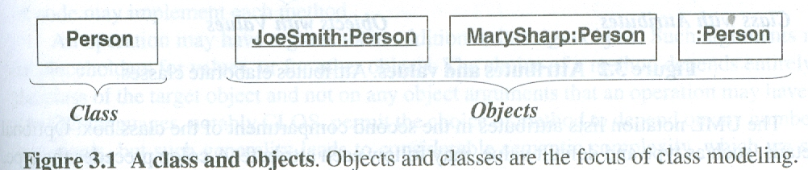
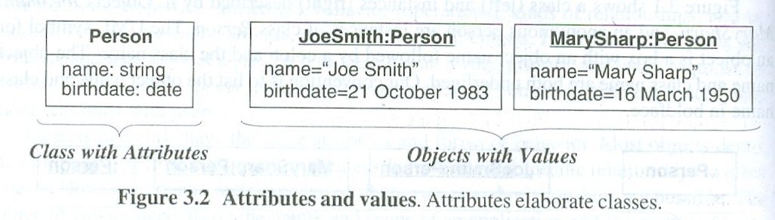
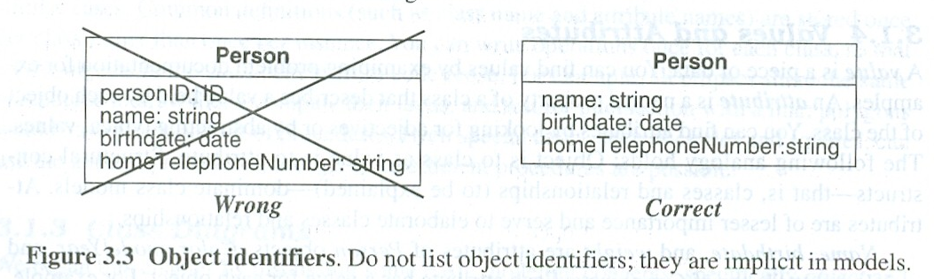

Slide 13
Classes of Objects
How many classes do you see?
Notes:
The answers you get will vary depending on the students’ perspectives on what they see, as well as the criteria they use to organize the objects shown on this slide. For example, some possible answers include:
Two classes: animals and non-animals
Two classes: Extinct and non-extinct things
Etc.

Slide 14
The Relationship Between Classes and Objects
A class is an abstract definition of an object
It defines the structure and behavior of each object in the class
It serves as a template for creating objects
Objects are grouped into classes
Objects
Class
Professor
Professor Smith
Professor Mellon
Professor Jones
Notes:
This may seem repetitive with earlier slides, but it has been noted that the repetition of the discrimination between objects and classes is beneficial to “newbies”. If this does not apply to your class, you can cover this slide briefly.

Slide 15
Class Diagram for the Sales Example
Sale
seller
buyer
item sold
shipping mechanism
Salesperson
Customer
Product
Vehicle
Corporate
Individual
Truck
Train
Notes:
Use this slide to review the key concepts and UML notation described earlier in this module. For example, ask the students the following:
What are the classes in this diagram?
What relationship exists between Salesperson and Sale?
What relationship exists between Corporate and Customer?
How would you interpret the diagram?

Slide 16
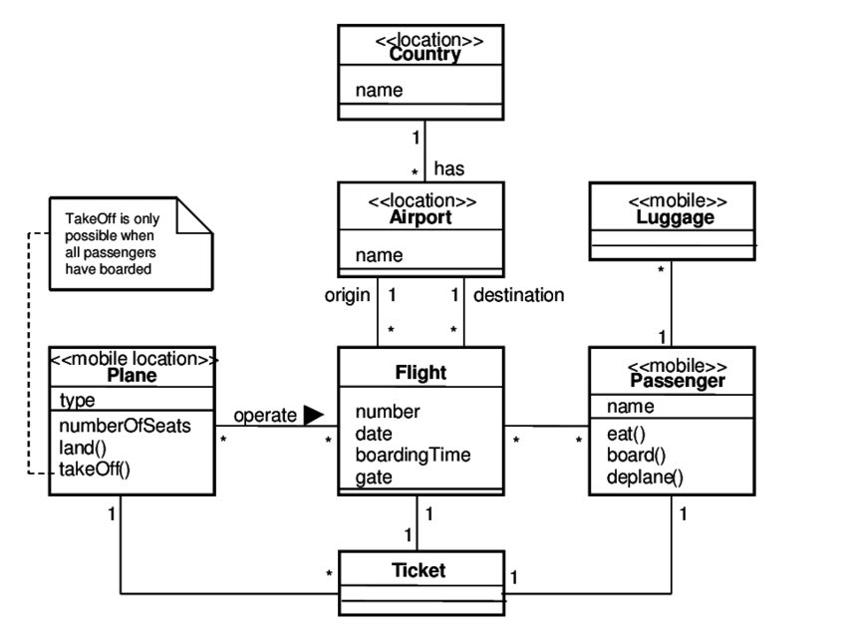
Class diagram for airlines system

Slide 17
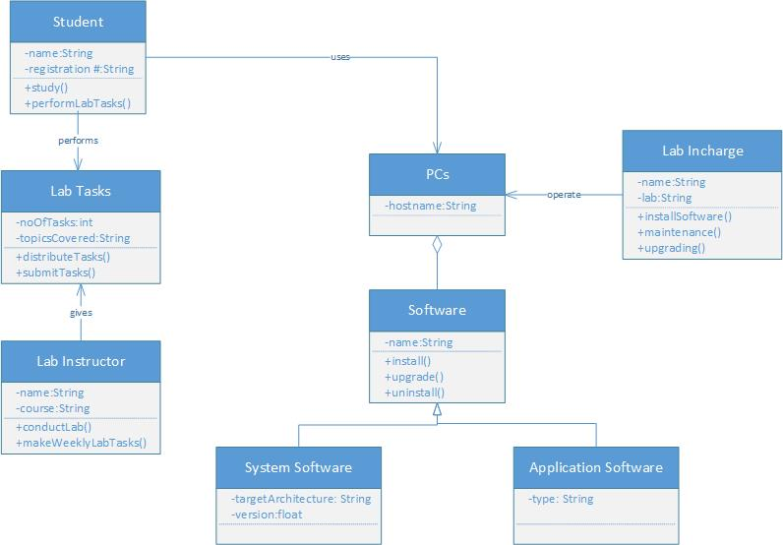
UML class diagram that models the working of computer labs in your department

Slide 18
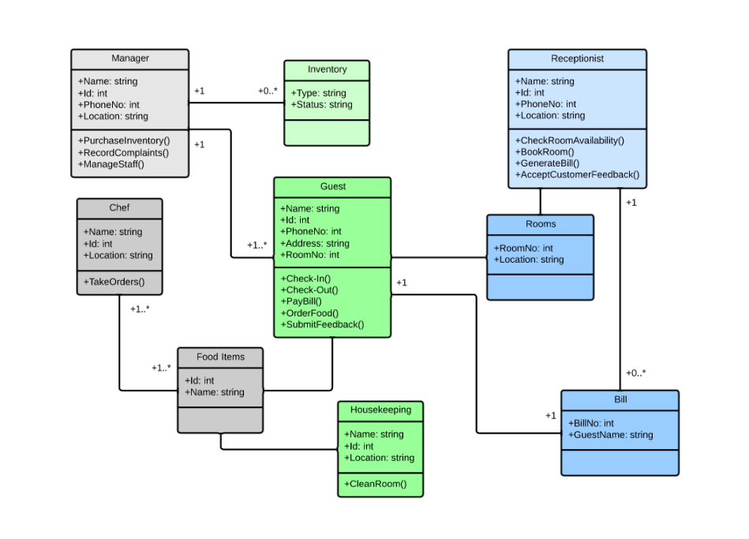
Class diagram for a hotel management system

Slide 19
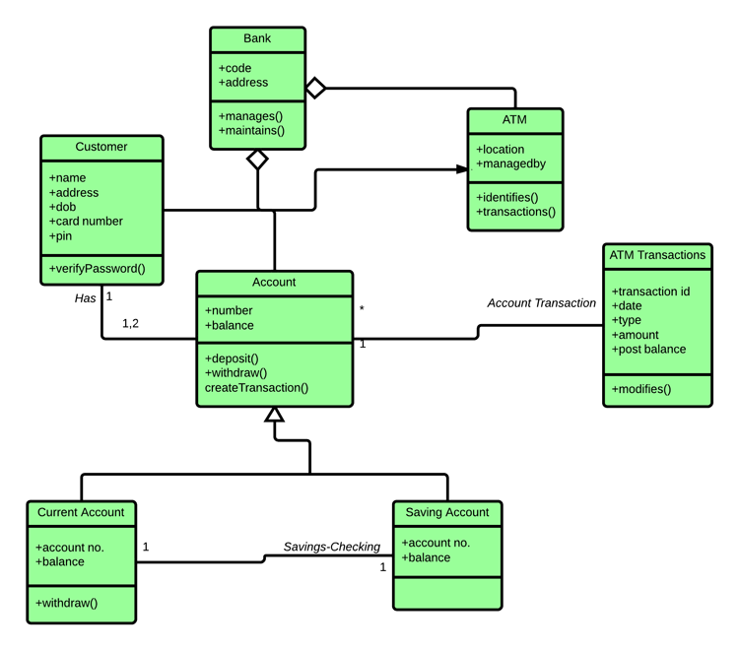
Class diagram for an ATM system

Slide 20
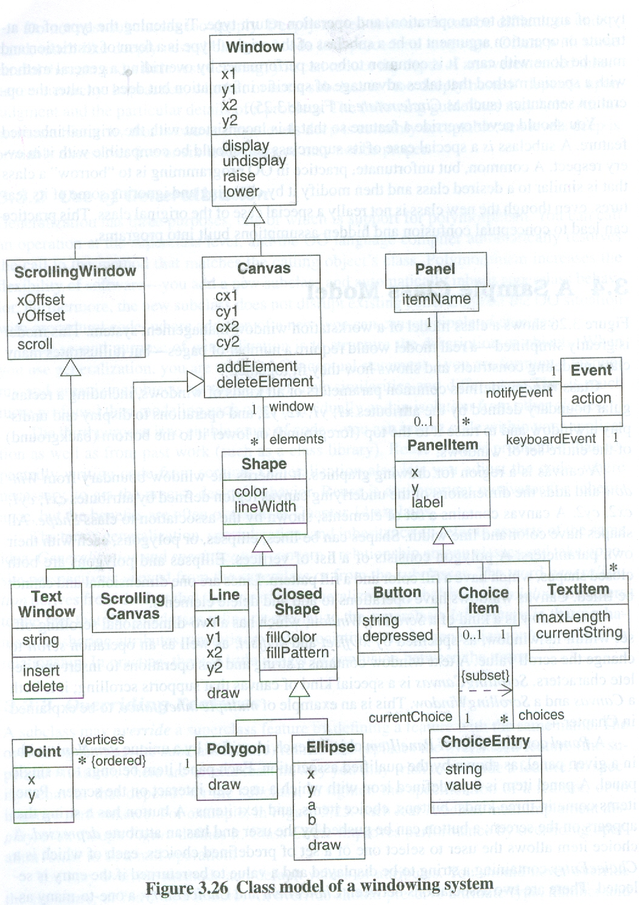

Slide 21
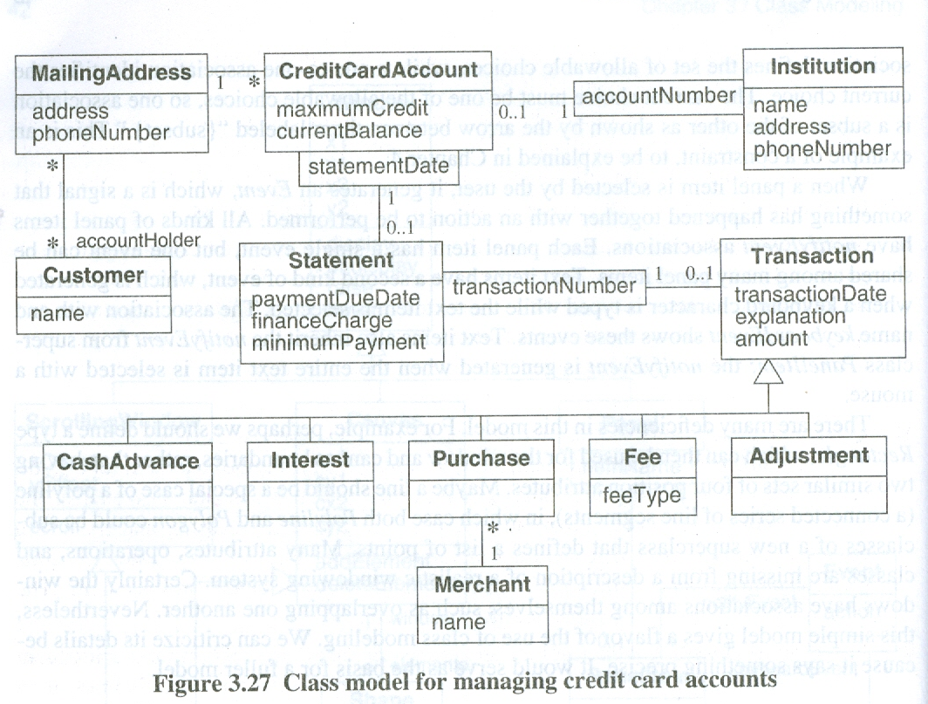

Slide 22
What is an Attribute?
Object
Class
Attribute
Attribute Value
:CourseOffering
number = 101
startTime = 900
endTime = 1100
CourseOffering
number
startTime
endTime
:CourseOffering
number = 104
startTime = 1300
endTime = 1500

Slide 23
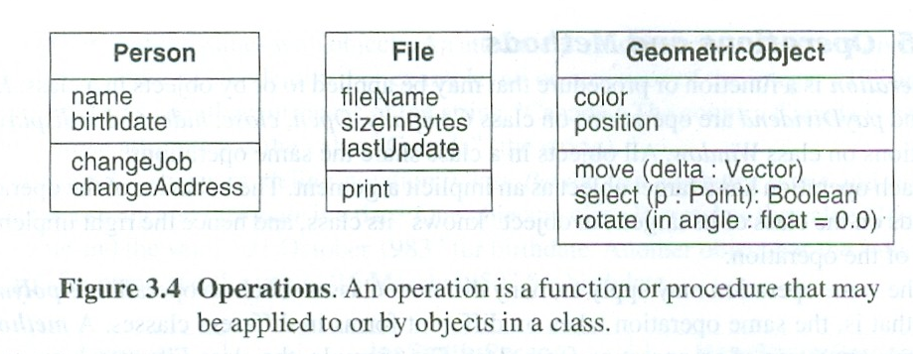
Operation
A function or service that is provided by all instances of a class
Types of operations:
Constructor: creates a new instance of a class
Query: accesses the state of an object but does not alter its state
Update: alters the state of an object
Scope: operation applying to the class instead of an instance
Operations implement the object’s behavior

Slide 24
What is an Operation?
CourseOffering
Class
addStudent
deleteStudent
getStartTime
getEndTime
Operation

Slide 25
Class Modeling
Link and Association Concepts

Slide 26
Link and association
Multiplicity
Association end name
Ordering
Association classes
Qualified association

Slide 27
Links and Association
A link is a physical or conceptual connection between objects .
Further, a link is also defined as an instance of an association.
In other words you can say that an association is a group of links with a common structure and common meanings

Slide 28
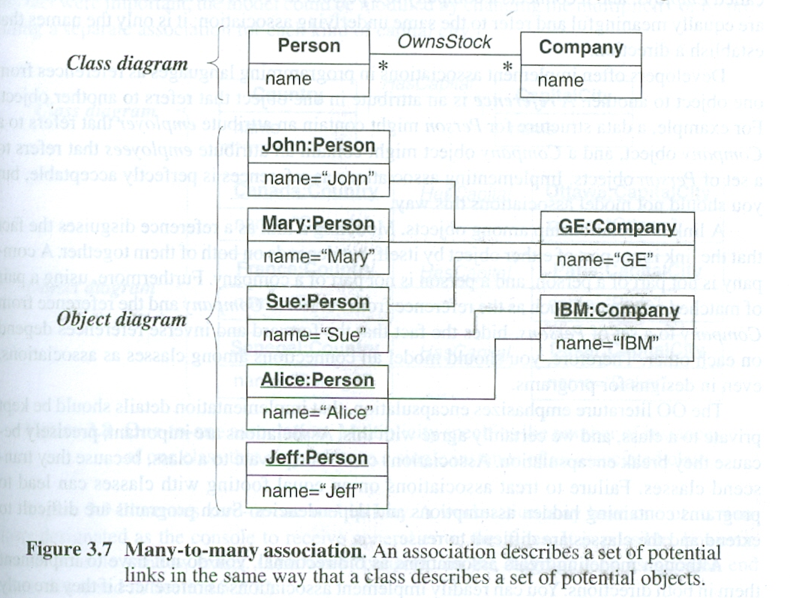

Slide 29
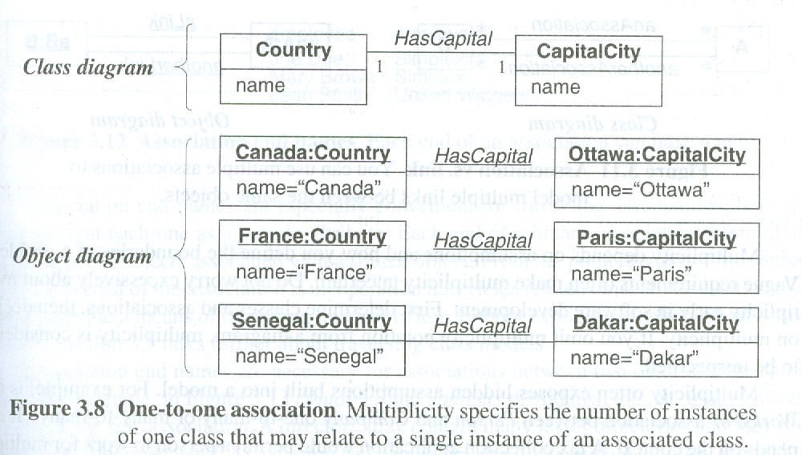

Slide 30
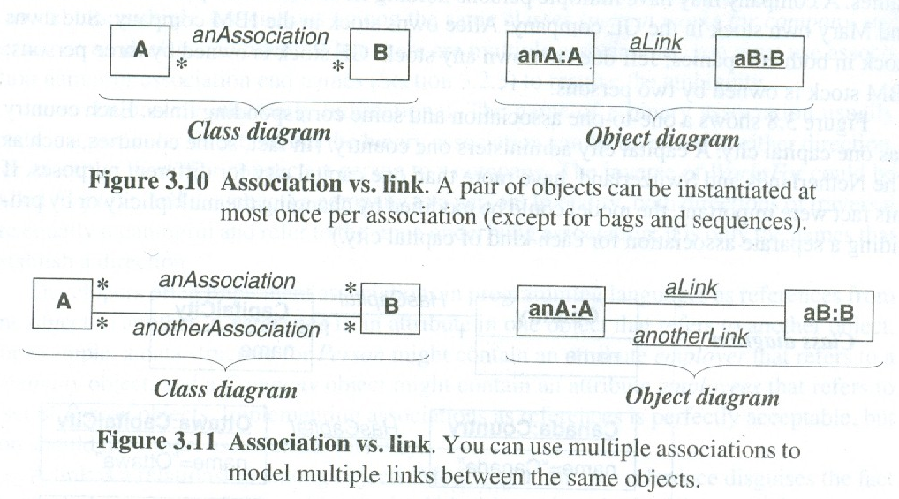

Slide 31
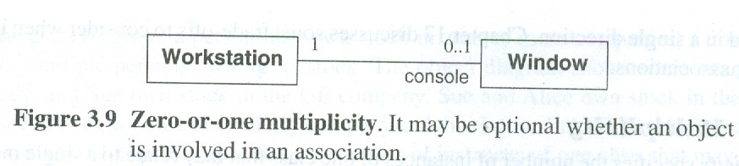
Multiplicity
Multiplicity in an association specifies how many objects participate in a relationship.
Multiplicity decides the number of related objects. Multiplicity is generally explained as “one” or “many,” but in general it is a subset of the non-negative integers.

Slide 32
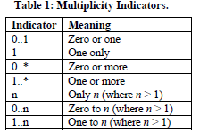

Slide 33
Association: Multiplicity
Unspecified
Exactly one
Zero or more (many, unlimited)
One or more
Zero or one
Specified range
Multiple, disjoint ranges
1
0..*
*
1..*
0..1
2..4
2, 4..6
Notes:
Specification of multiplicity flushes out business rules and assumptions. The lower bound is critical, as the lower bound is what determines whether or not the relationship is optional (e.g., a lower bound of 0 indicates that the relationship is optional).
Multiplicity is needed on both ends of a relationship, even if you can only navigate in one direction. Even though there is no need to navigate in that direction, the multiplicity still provides valuable business information. Sometimes navigation decisions are made for performance reasons, which may change over time. The multiplicity should reflect the requirements.
Navigation is discussed on later slides.
The use of ‘N’ instead of ‘*’ is Booch, not UML (e.g., the use of “0..N” and ‘N’ is not UML).

Slide 34
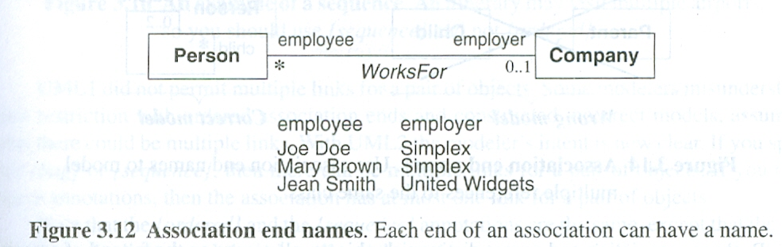
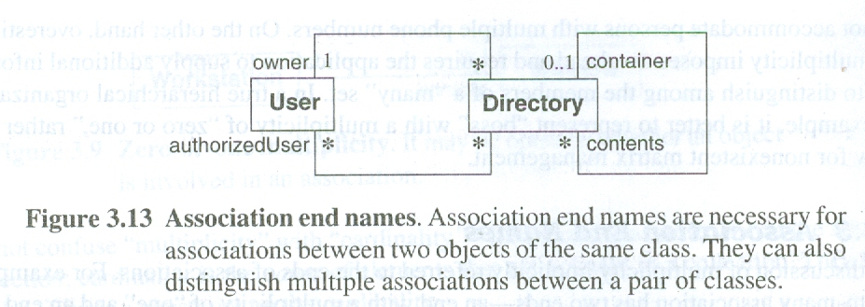
Association end name
We can not only assign multiplicity to an association end but we can assign it a name as well .

Slide 35
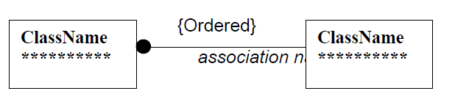
Ordering
Usually the objects on the "many" side of an association have no explicit order, and can be regarded as a set. Some times the objects on the many side of an association have order. Writing {ordered} next to the multiplicity dot as shown in next Figure indicates an ordered set of objects of an association.

Slide 36
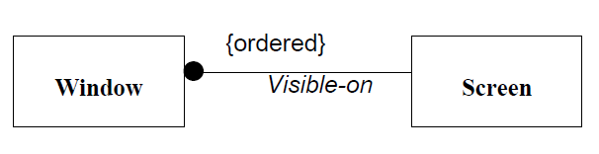
Consider the example of association between Window class and Screen class. A screen can contain a number of windows. Windows are explicitly ordered. Only topmost window is visible on the screen at any time. Next Figure
shows this example.

Slide 37
Association classes
An association class is an association that is also a class .
Like a class an association class can have attribute and operations and participate in associations .
Like the links of an association the instance of an association class derive identity from instance of the constituent class .

Slide 38
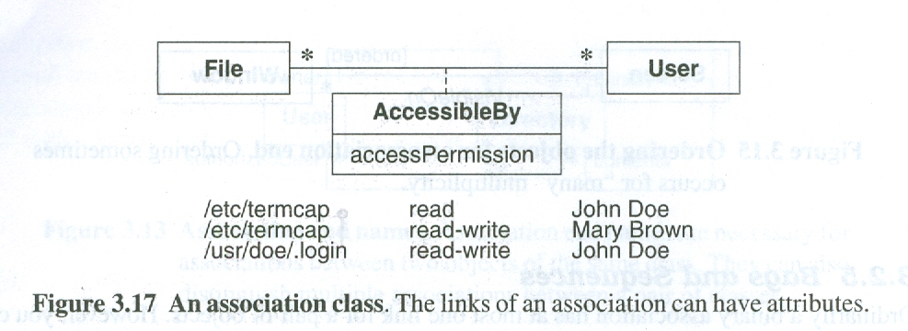
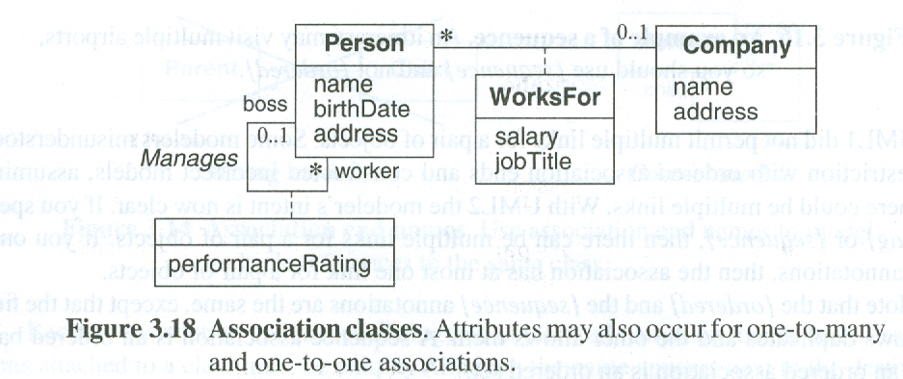

Slide 39
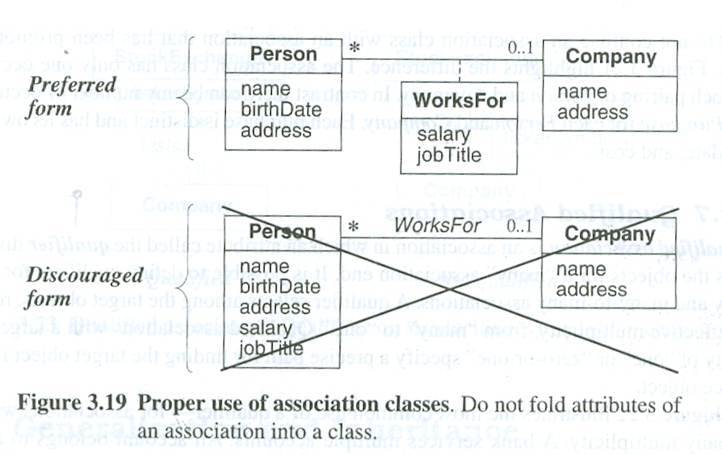

Slide 40
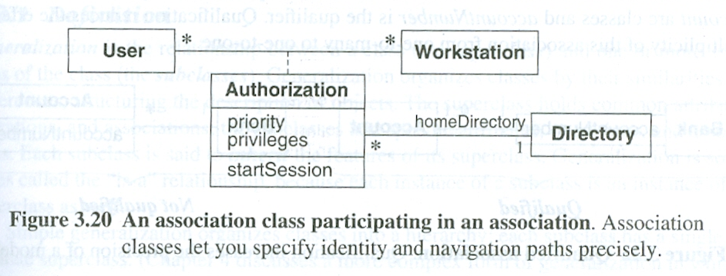
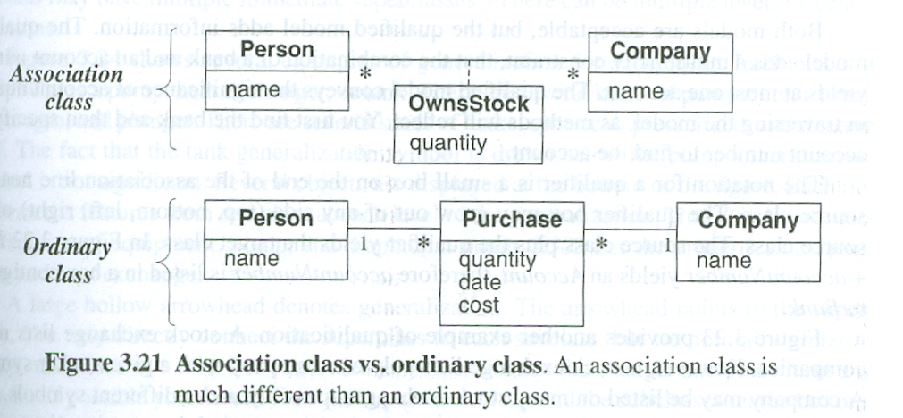

Slide 41
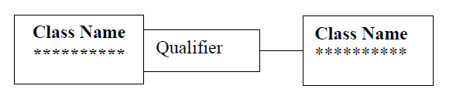
Qualified association
A qualifier is an association attribute. A qualified association relates two object classes and a qualifier. The qualifier is a special attribute that reduces the effective multiplicity of an association. One-to-many and many-to-many
associations may be qualified. Figure given below shows how to represent a qualification.

Slide 42
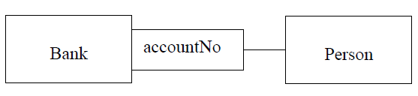
The qualifier is drawn as a small box on the end of the association line near the class it qualifies. The qualifier rectangle is part of the association, not of class. The qualifier distinguishes among the set of objects at the "many" end of an association. A qualified association can also be considered a form of ternary association. The advantage of the qualification is that it improves semantic accuracy and increases the visibility of navigation paths.
For example, a person object may be associated to a Bank object as shown in Figure given below . An attribute of this association is the accoutNo. The accountNo is the qualifier of this association.

Slide 43
Class Modeling
Relationship

Slide 44
Relationships
There are two types of relationships:
Static (compile-time)
Inheritance is a relationship between two classes that is formed at compile time
The subclass inherits all attributes, method implementations and relationships of its super class
Dynamic (run-time)
Dynamic relationships are links between objects that are established at run-time
Dynamic relationships are motivated by objects needing to communicate with others to do useful work
A link with another object forms part of an object’s state
Notes:
Objects are not island and must collaborate to be useful. To collaborate, objects must be linked via a relationship.
E.g. vehicle registration database for the DVLA – might have Person objects and Vehicle objects – asking a Person object for the registration numbers of any vehicles registered to them involves communicating with any associated Vehicle objects.
State of a Person object includes name, address and the links to their registered Vehicle objects.
Transient links – people buy and sell vehicles so links are made and broken respectively.

Slide 45
Relationships: Association
Models a semantic connection among classes
Association Name
Professor
Works for
University
Association
Role Names
Class
Professor
University
Employee
Employer
Notes:
Associations connect instances of two or more classes together for some duration (as opposed to a dependency relationship, which represents a temporary association between two instances).
Dependency relationships will be discussed in the Class Design module.
Do not use relationship/role names if they add no value/information to the model. Remember, readability and understandability of the model are key -- only add information that adds value, not clutter to the diagrams.

Slide 46
Association
Associations are, by default, bidirectional
However, it is not always necessary or even desirable to have a bidirectional relationship
Bidirectional relationships introduce mutual dependencies
Employer is dependent on Employee and vice versa
Unidirectional relationships are simpler and reduce dependencies among classes
LinkedList knows nothing of AddressBook, but AddressBook knows about LinkedList
Notes:
You have to be careful implementing bidirectional associations – see supporting code for later.
Unidirectional associations are better for reuse – see later.
Unidirectional associations are shown with a solid directed line from the using-class to the used-class.

Slide 47
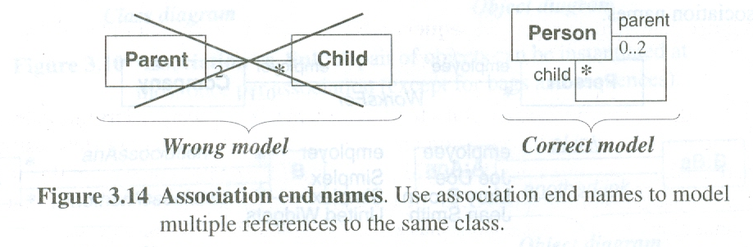

Slide 48
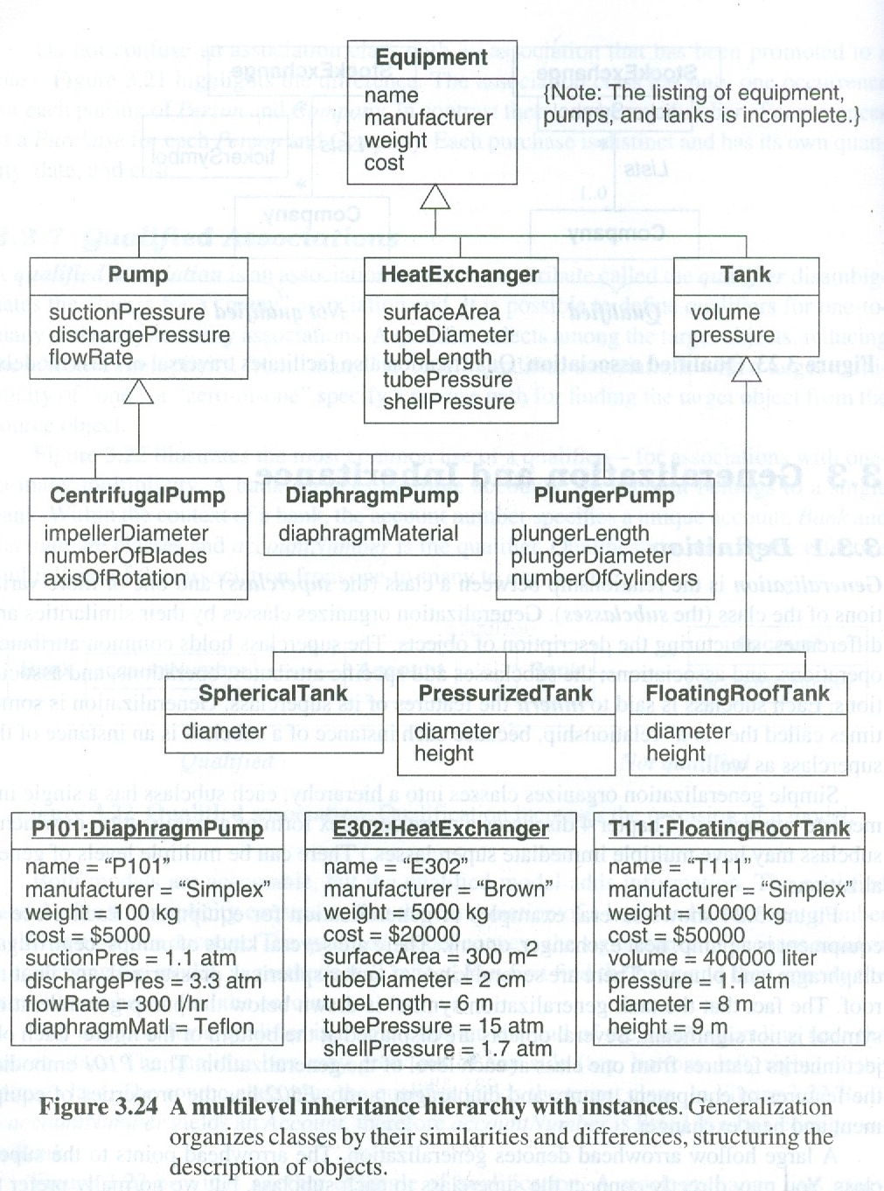

Slide 49
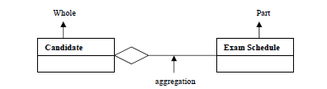
Aggregation
Aggregation is a special form of association, which models the “part-whole” or “apart-of” relationship as an aggregate (the whole) and parts. The most considerable property of aggregation is transitivity, that is, if X is part of Y and Y is part of Z, then X is part of Z. Aggregation is seen as a relationship in which an assembly class is related to component class. In this component objects are not having separate existence, they depend on composite objects as you can see in Figure 7 Exam Schedule is not having separate existence.

Slide 50
Relationships: Composition
A form of aggregation with strong ownership and coincident lifetimes
The parts cannot survive the whole/aggregate
Whole
Part
Student
Schedule
Aggregation
Notes:
Explain to the students that the diamond on this slide must be filled in with black so that the books would print right. If it was filled in with white, it would not be filled in in the books.
Note: Compositional aggregation can be shown in by nesting one class within another; however, Rose does not directly support the drawing of a class within a class.
Composition is not equivalent to containment by value, as some languages do not support containment by value (e.g., Java). By-value vs. by-reference is an implementation “thing”, whereas composition is a conceptual “thing” that can realized in the implementation using by-value, or by-reference (if the distinction is supported).
Note: In Rose, composition is modeled by specifying “by-value” for the containment property of a role of a relationship.

Slide 51
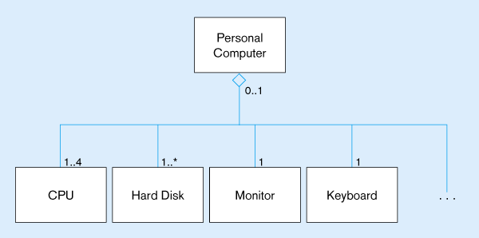
Figure 14-14 Example of aggregation
A Personal Computer includes CPU, Hard Disk, Monitor, and Keyboard as parts. But, these parts can exist without being installed into a computer. The open diamond indicates aggregation, but not composition

Slide 52
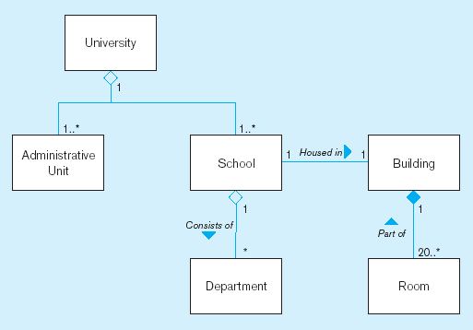
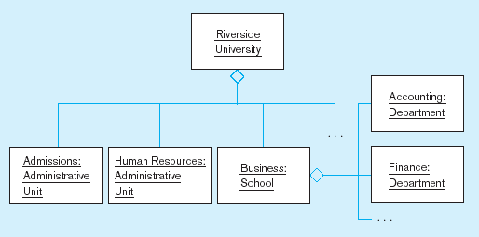
Figure 14-15 Aggregation and Composition
(a) Class diagram
Closed diamond indicates composition. The room cannot exist without the building
(b) Object diagram

Slide 53
Relationships: Dependency
A relationship between two model elements where a change in one may cause a change in the other
Non-structural, “using” relationship
Class
Client
Supplier
Component
Package
Client
Supplier
Dependency relationship
ClientPackage
SupplierPackage
Dependency relationship

Slide 54
Relationships: Generalization
A relationship among classes where one class shares the structure and/or behavior of one or more classes
Defines a hierarchy of abstractions in which a subclass inherits from one or more super classes
Single inheritance
Multiple inheritance
Generalization is an “is-a-kind of” relationship
Notes:
Generalization relationships are also permitted between packages. However, since packages do not themselves have any semantics, generalization between packages is not very common (generalization amongst subsystems, however, is practical).
According to Grady Booch: “The terms “inheritance” and “generalization” are, practically speaking, interchangeable. The UML standardized on calling the relationship “generalization” so as not to confuse people with language-specific meanings of inheritance. To confuse matters further, some call this an “is-a” or a “kind of” relationship (especially those into conceptual modeling in the cognitive sciences). So, for most users, it’s fair to use either term. For power users - people who care about things like the UML metamodel and specifying formal semantics of the same, the relationship is called “generalization” and applying such a relationship between, for example, two classes, results in the subclass inheriting the structure and operations of the superclass (i.e. inheritance is the mechanism).

Slide 55
Generalization/Specialization
Subclass, superclass
similar to subtype/supertype in EER
Common attributes, relationships, and operations
Disjoint vs. Overlapping
Complete (total specialization) vs. incomplete (partial specialization)
Abstract Class: no direct instances possible, but subclasses may have direct instances
Concrete Class: direct instances possible

Slide 56
Constraints
A constraint is a Boolean condition involving model elements such as objects, classes, link, attribute ,association and generalization set. A constraint restrict the values that elements can assume.
Constraints on objects
Constraints on generalization set
Constraints on links

Slide 57
Inheritance
One class inherit the property
of another class
Main Class
Base Class
Sub Class
Derived Class

Slide 58
Inheritance
Inheritance is a way to form new classes using classes that have already been defined. Inheritance is intended to help reuse existing code with little or no modification. The new classes, known as derived classes (or child classes or sub classes), inherit attributes and behavior of the pre-existing classes, which are referred to as base classes (or parent classes or super classes) as shown in Figure below . The inheritance relationship of sub- and super classes gives rise to a hierarchy.
Inheritance is a “is-a” relationship between two classes. For example, Student is a Person; Chair is Furniture; Parrot is a Bird etc. in all these examples, first class (i.e. Student, Chair, Parrot) inherits properties from the second class (i.e. Person, Furniture, Bird).

Slide 59
Example of Inheritance
Base Class
Grand Father
Derived Class for
Grand Father Class
Father
Father
Base Class for
Grand Father Class
Child
Child
Child
Child
Derived Class For Father Class

Slide 60
There are several reasons to use inheritance as enumerated below
• Inheritance for specialization
• Inheritance for generalization
• Inheritance for extension
• Inheritance for restriction
• Inheritance for overriding

Slide 61
Types of Inheritance
There are many ways a derived class inherits properties from the base class.
Following are the types of inheritance:
• Single Inheritance
• Multiple Inheritance
• Multilevel Inheritance
• Hierarchical Inheritance
• Multipath/ Hybrid Inheritance

Slide 62
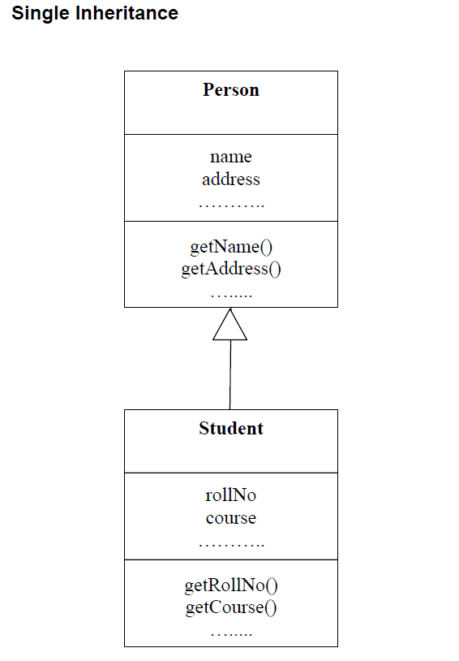
Single Inheritance
When a (derived) class inherits properties (data and operations) from a single base class, it is called as single inheritance.
In single inheritance, a class is allowed to inherit from only one class. i.e. one sub class is inherited by one base class only.
For example, Student class inherits properties from Person class as shown in Figure

Slide 63
Example: Single Inheritance
One class inherits from another
Ancestor
Account
balance
Superclass (parent)
name
number
Withdraw()
CreateStatement()
Generalization Relationship
Checking
Savings
Subclasses
Withdraw()
GetInterest()
Withdraw()
Descendents

Slide 64
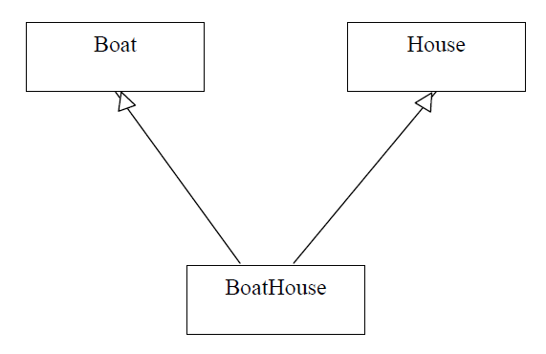
Multiple Inheritance
When a (derived) class inherits properties (data and operations) from more than one base class, it is called as multiple inheritance. For example,
BoatHouse class inherits properties from both Boat class and House class as
shown in Figure

Slide 65
Example: Multiple Inheritance
A class can inherit from several other classes
FlyingThing
Animal
multiple
inheritance
Airplane
Helicopter
Bird
Wolf
Horse
Use multiple inheritance only when needed, and
always with caution !

Slide 66
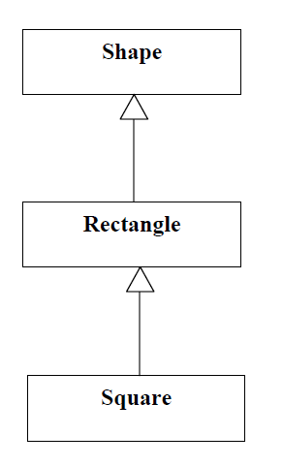
Multilevel Inheritance
When a (derived) class inherits properties (data and operations) from another derived class, it is called as multilevel inheritance. For example, Rectangle class inherits properties from Shape class and Square inherits properties from Rectangle class as shown in Figure

Slide 67
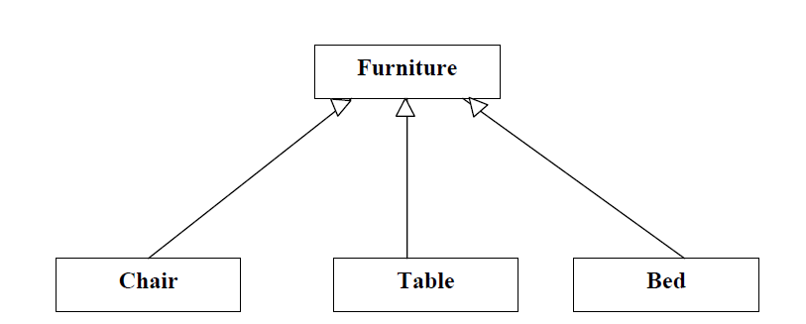
Hierarchical Inheritance
When more than one (derived) class inherits properties (data and operations) from a single base class, it is called as hierarchical inheritance. For example, Chair class, Table class and Bed class all inherit properties from Furniture class as shown in Figure

Slide 68
Multipath Inheritance
When more than one inheritance paths are available between two classes in the inheritance hierarchy, it is called as multipath inheritance. For example, Carnivorous and Herbivorous class inherit properties from Animal class.
Omnivorous class inherits properties from Carnivorous and Herbivorous classes. So, there are two alternative paths available from Animal class to Omnivorous class as shown in Figure

Slide 69
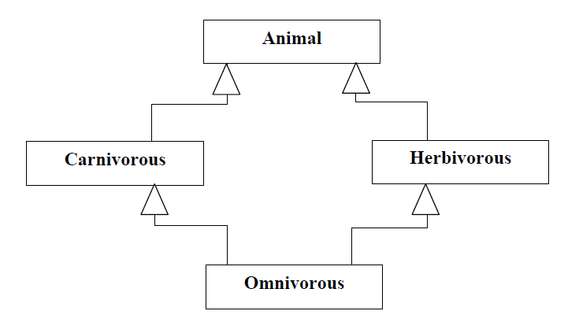

Slide 70
MULTIPATH INHERITANCE
In a two-level inheritance, it is possible that a child will have two parent classes. However, the two parent classes may be derived from a single grandparent class.

Slide 71
Hybrid inheritance
Hybrid inheritance is a combination of multiple inheritance and multilevel inheritance. A class is derived from two classes as in multiple inheritance. However, one of the parent classes is not a base class. It is a derived class.

Slide 72
